Slide 1
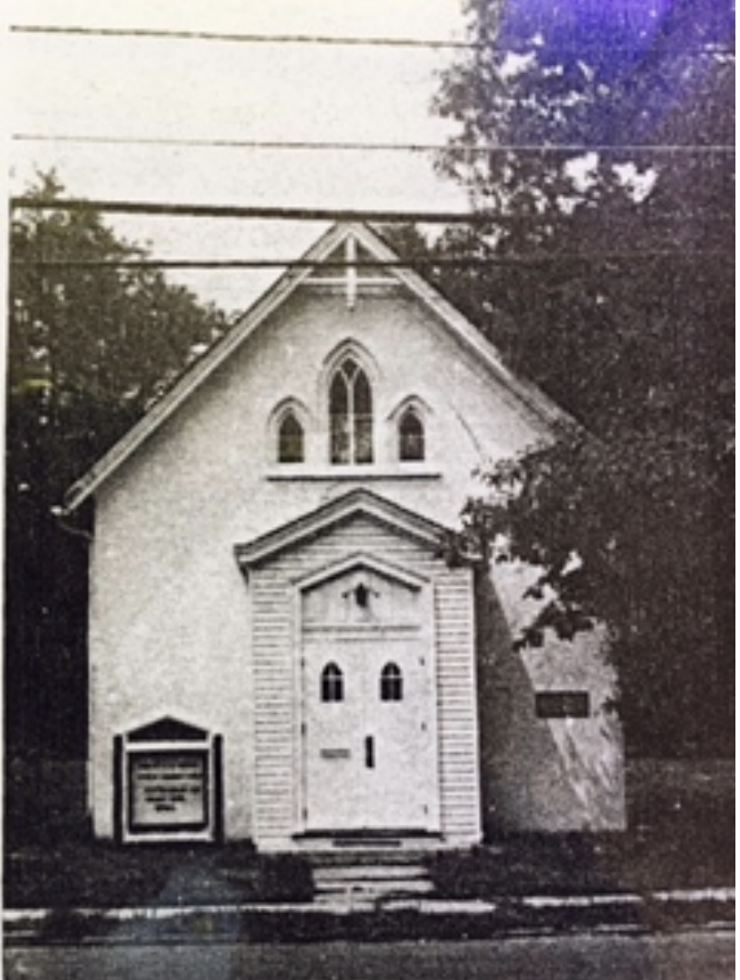
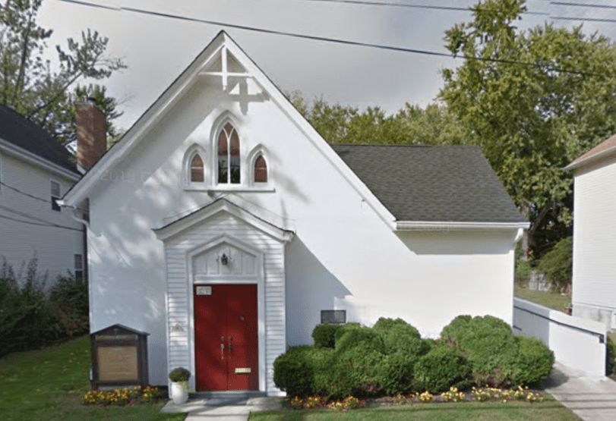
Pennington AME Church
Then - church
Now - For sale
The African Methodist Episcopal denomination was founded by Richard Allen, a formerly enslaved person, who established the church in 1794 as a response to racism by white Methodists. The Bethel AME Church in Pennington was founded in 1816. The AME congregation met in private homes on South Main Street until the church was built in 1847. For close to two centuries, the Bethel AME Church has been an important meeting place not only for Black Pennington residents but for parishioners who traveled from as far as Trenton, Princeton, and surrounding areas for worship, church picnics, and celebrations. Even Former First Lady Michelle Obama once came here when she was a student at Princeton. It is now for sale and neighbors hope to buy it and make it a museum

Slide 2
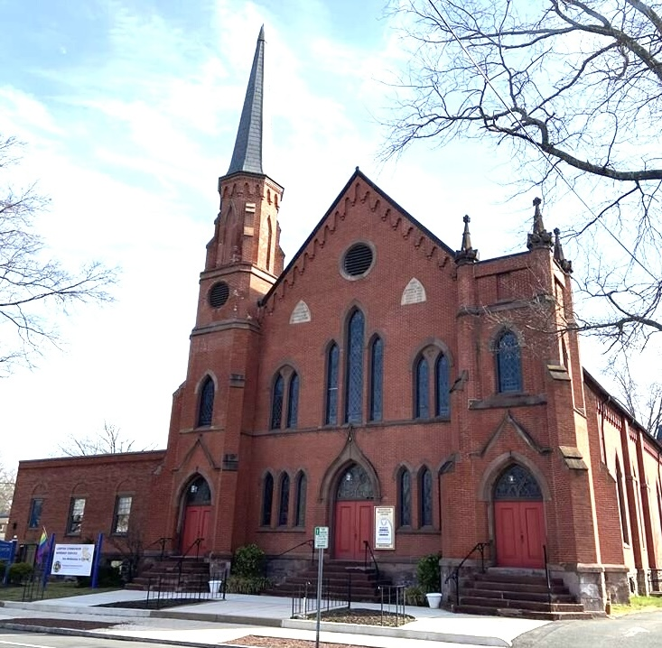
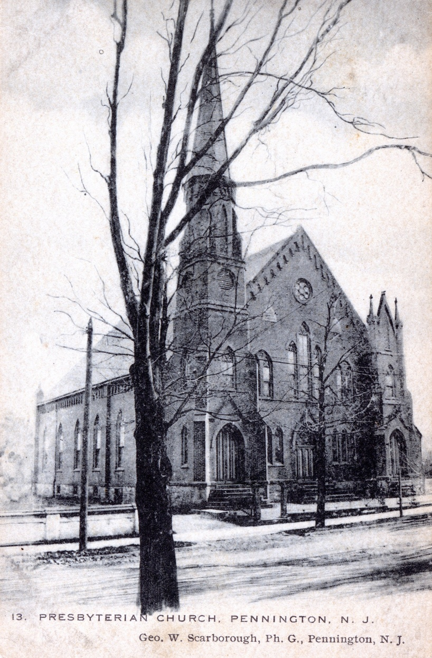
Pennington Presbyterian Church
Then - church
Now – church
In 1709, the first European settlers in the area started meeting in each other’s homes for church services. The first church building was made of wood in 1734. Many of the people who went to this church fought in General Washington’s army during the Revolutionary War. The wooden church burned down in 1874. One year later, this red brick church was built and has served the community ever since.

Slide 3
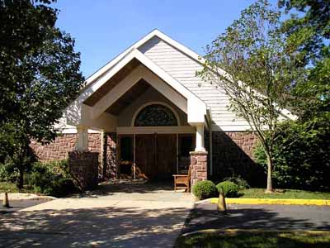
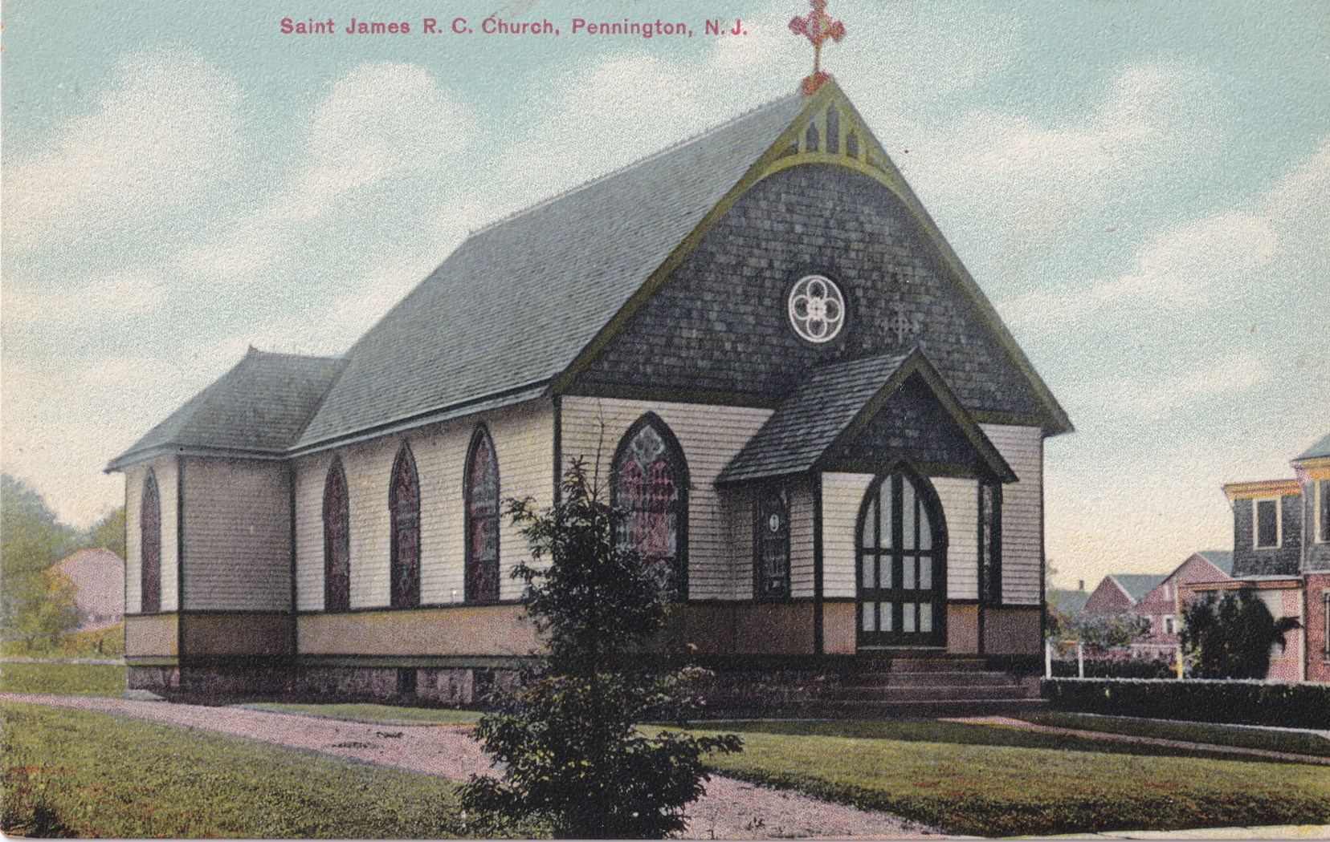
St James Church
Then - church
Now - church
This church was started by five families who had moved here from Ireland in the 1890s. The people who formed the church dug the basement and built the church building by hand. By 1965, so many people had joined the church – 1500 families - that they had to build a new, much bigger building. That’s where people go now.

Slide 4
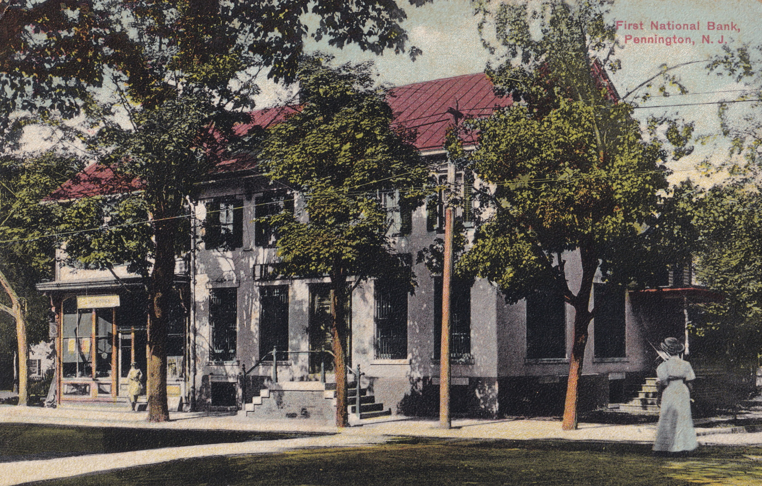
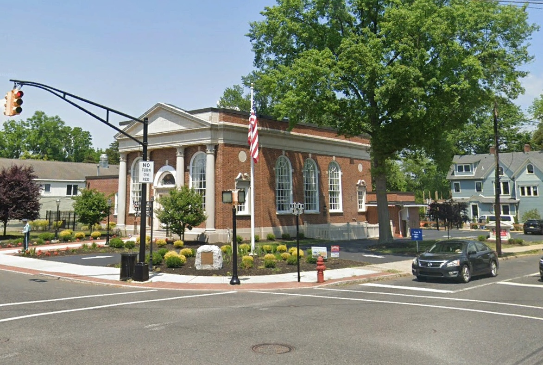
Bank Building
Then – First National Bank
Now – For sale
In 1900, there was no bank in town, so some of the people in town got together and decided to make one. They all pitched in some money to make the bank and they rented one room in the wooden house at the corner of East Delaware and Main. That building was a tavern built in 1790. By 1901, they had six electric lights and a telephone. Having outgrown that structure by the mid-1920’s, the bank made plans for an imposing bank building. The new structure was a hit with local residents. At its grand opening on May 27, 1927, it attracted a throng of over 1,500 people. The bank closed a few years ago and now the building is for sale.

Slide 5
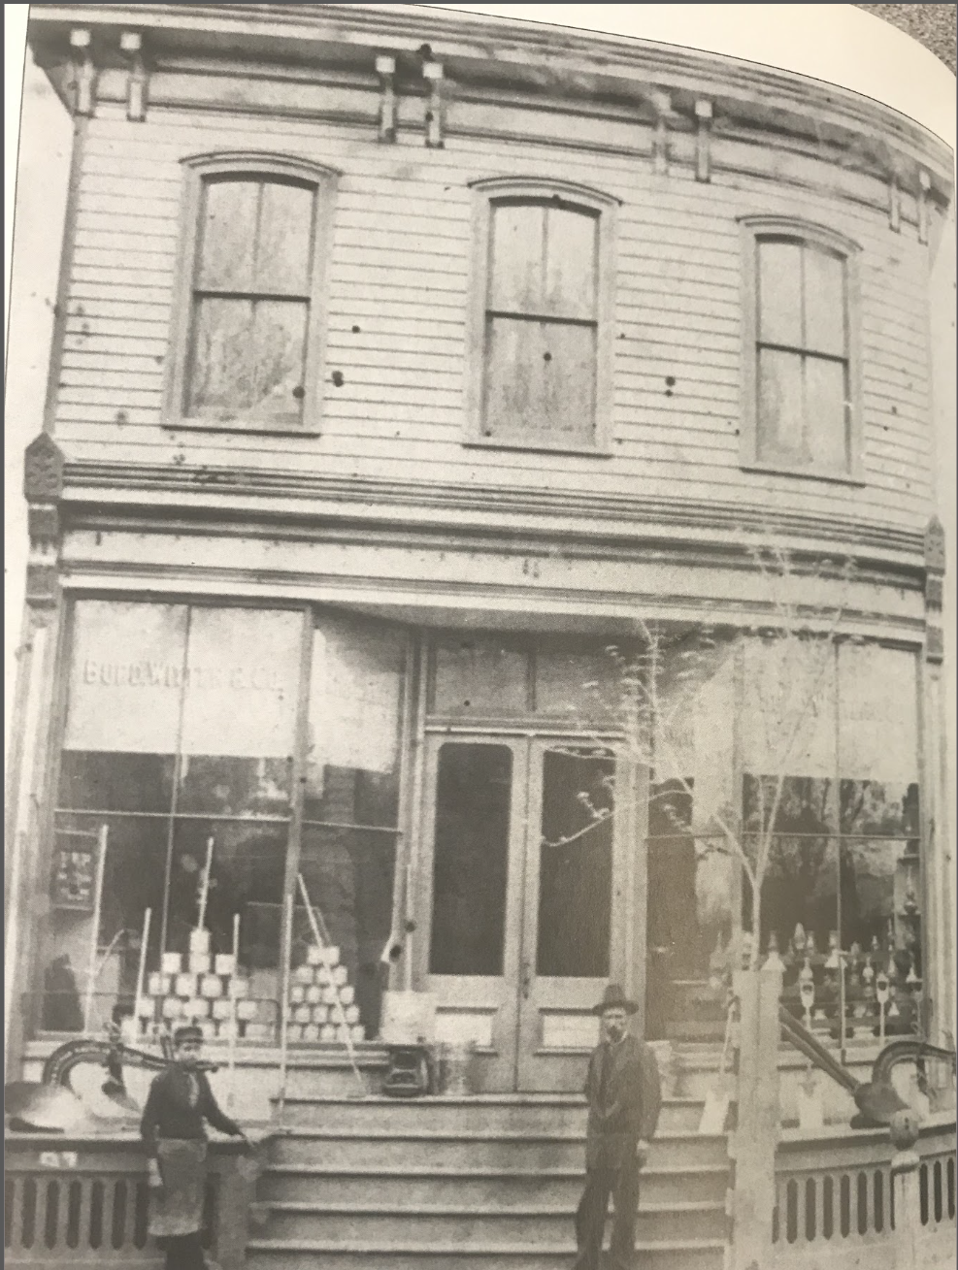
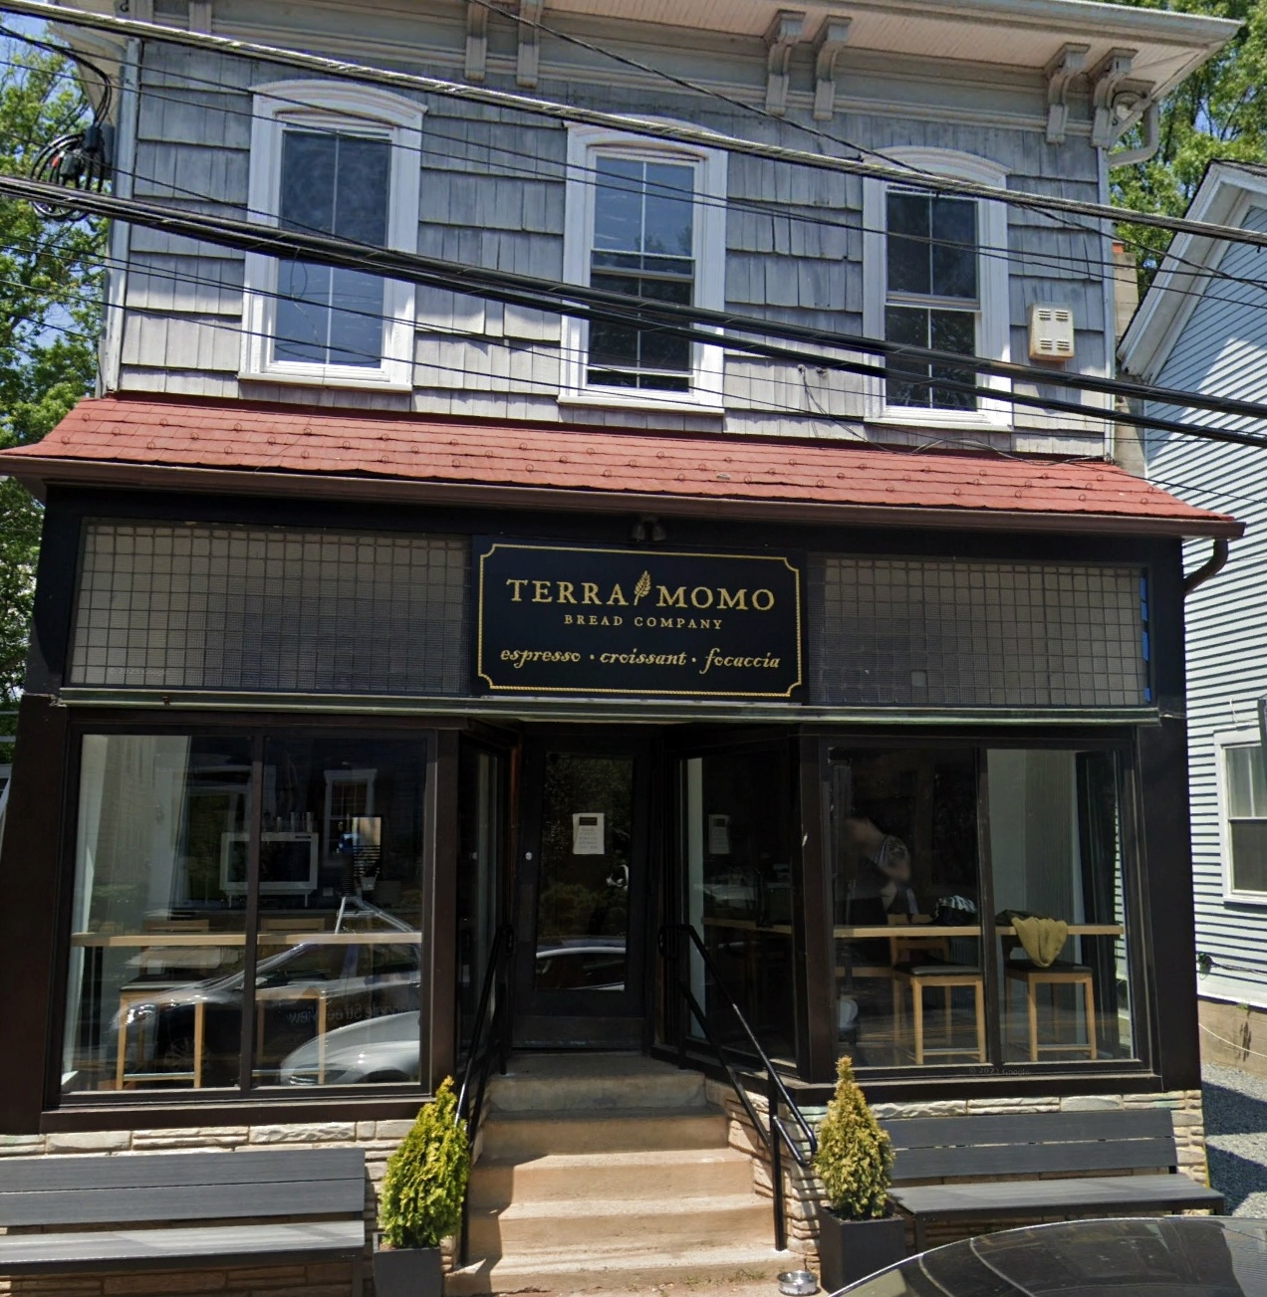
Hardware Store
Then – Burd Witter & Co. Hardware
Now – Bread Bakery
This building was built around 1850 by Burd, Witter and Co. and continuously used as a hardware store until just a few years ago. For more than 150 years, neighbors could buy their hammers, nails, paint, and anything else needed to fix things there. The last owner sold the store just before the COVID epidemic to Terra Momo, who make good bread and pastries.

Slide 6
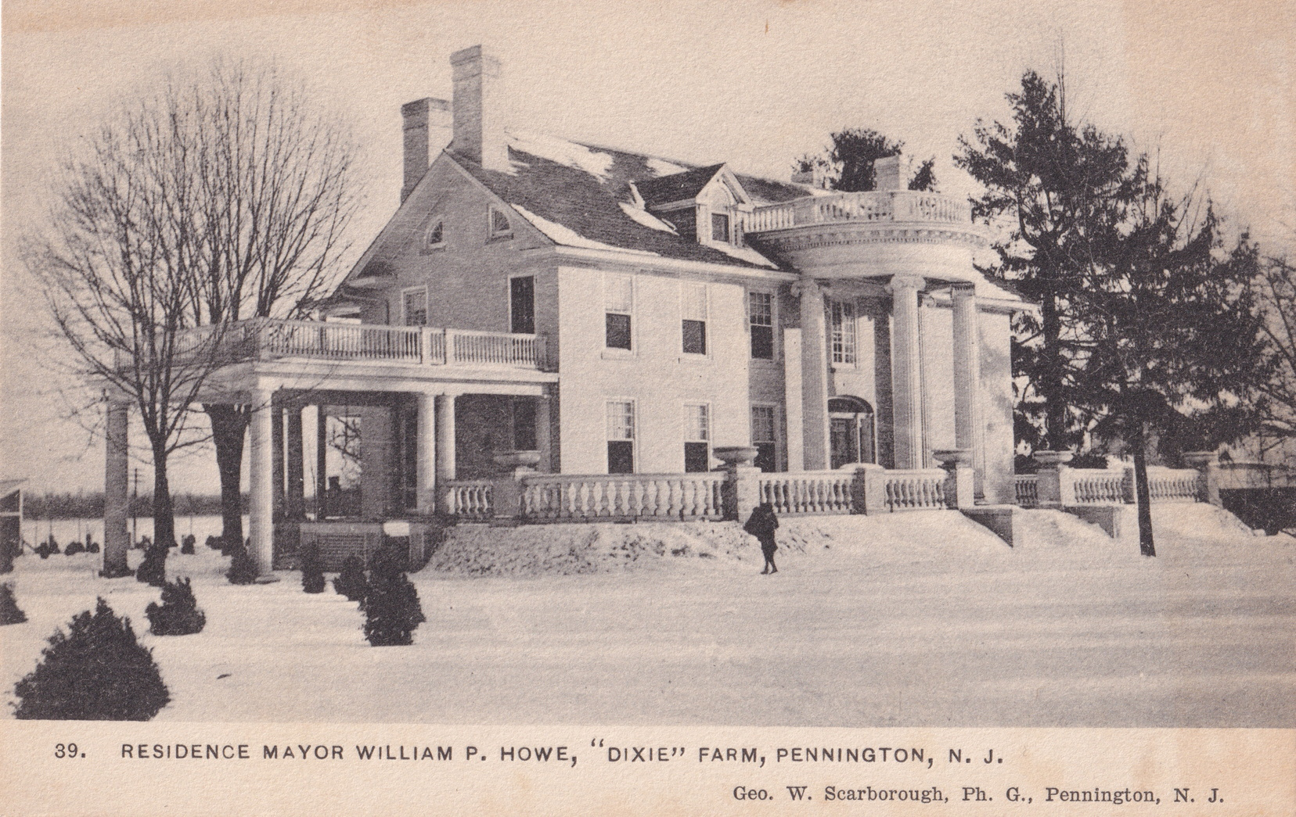
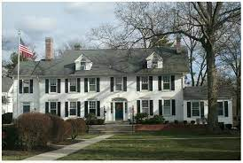
Howe Commons
Then - House
Now - Office Building
William Howe moved to Pennington in 1910 and bought this house. He had been in poor health and found out that working in his yard made him feel better. He turned his love for gardening into a business and for decades, most of the southern portion of Pennington was Howe Nursery. There were 2500 shade trees and 60,000 peonies! Now there are houses where those gardens were. Many of the people who lived in that area worked there too. The building is now used for offices.

Slide 7
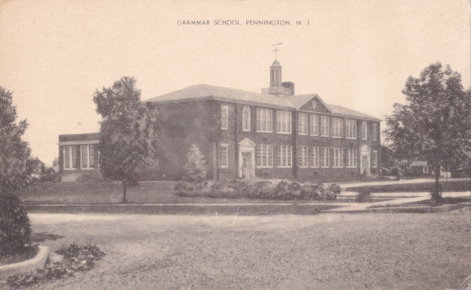
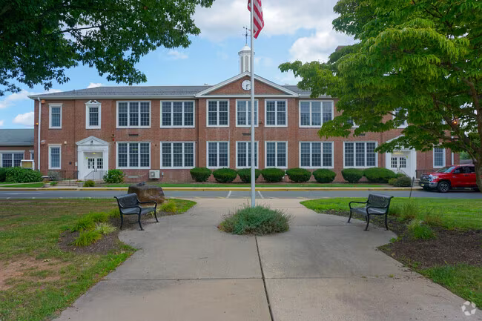
Toll Gate Elementary
Then - School
Now - School in 1924, the Pennington Elementary School was so badly overcrowded that the people in town voted to build a new one on Main Street . Mr. Howe donated land near his nursery business for it. The building had 8 classrooms, an auditorium, an office and a teachers’ room and cost approximately $112, 000. School started here in May 1926. The Toll Gate name comes from the building on South Main Street near the school that was the residence of a gatekeeper who collected tolls on Main Street in the second half of the 1800s.

Slide 8
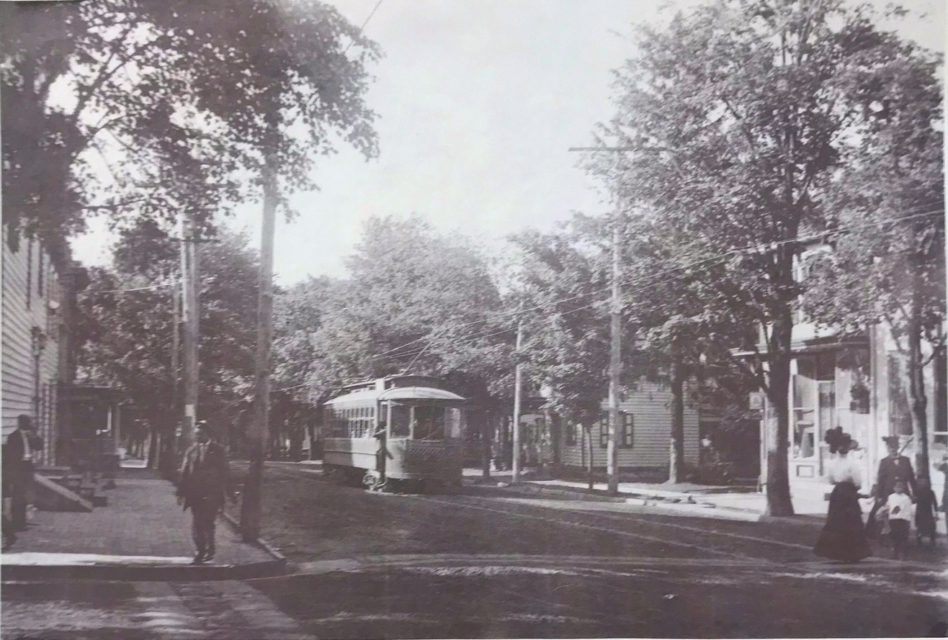
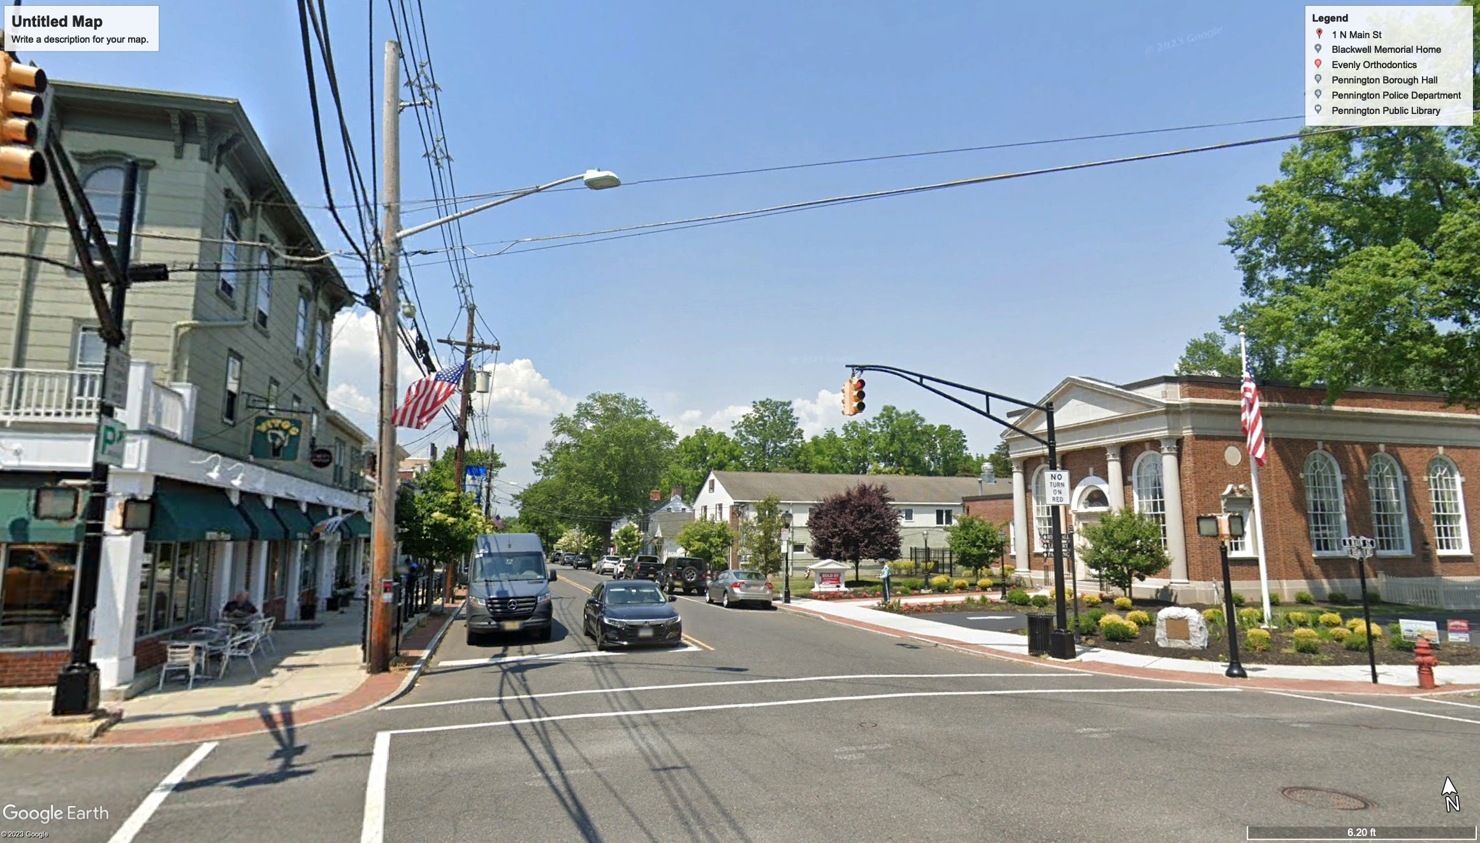
Main Street
Then - Trolley line
Now - Cars only
In 1902, the trolley line was built in Pennington to extend the whole way to Trenton. With this transportation, even kids could go to Trenton for the afternoon to go to the movies or shopping and their parents could use the trolley to get to work in the city. The trolley line was taken up in 1931 when cars and busses became more popular.

Slide 9
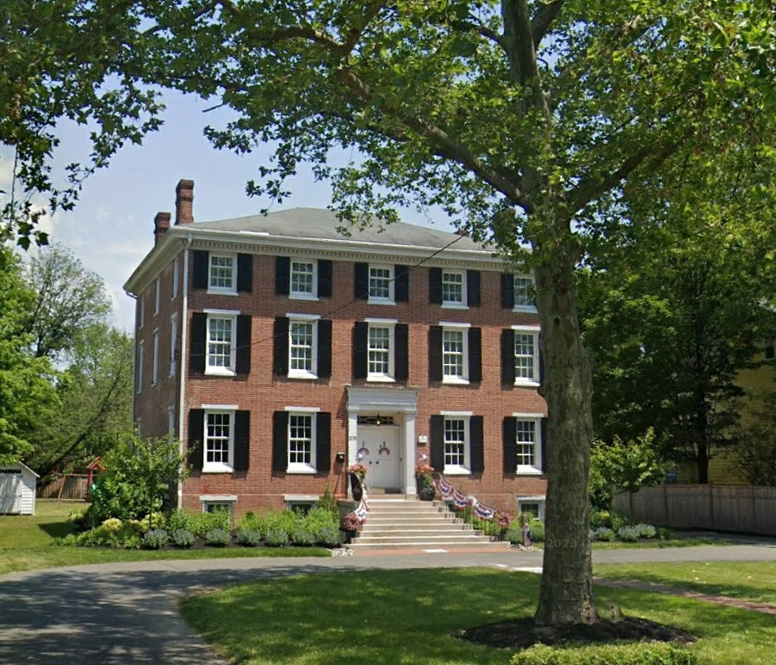
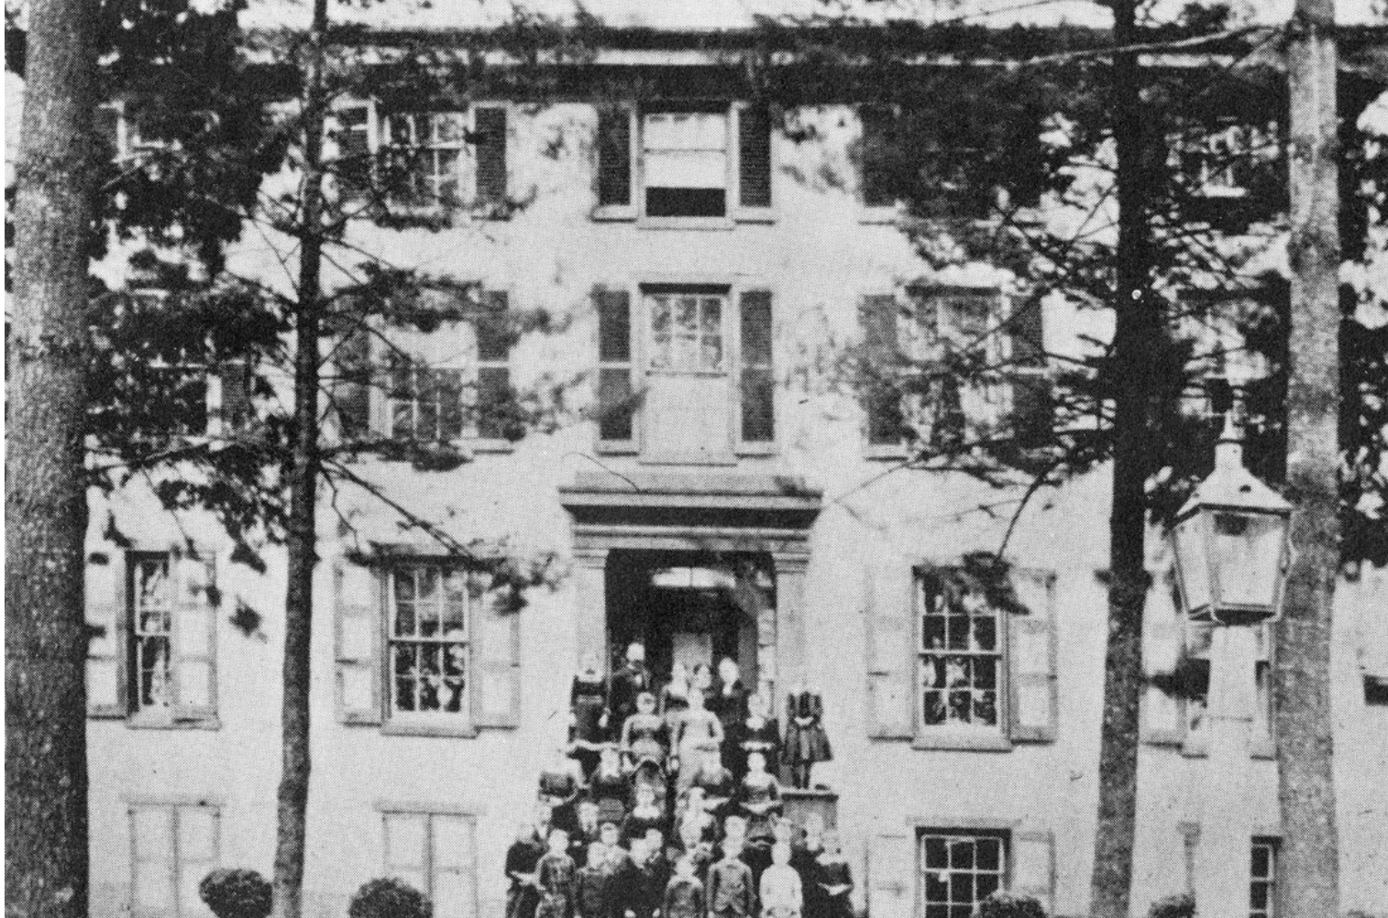
Evergreen Hall
Then – a school for girls
Now – a house
This building was constructed in 1836 as a school for women known as Evergreen Hall. It was named by its principal, Ms. Anna Welling . Evergreen Hall stressed not only academic subjects but cultural and spiritual aspects of living. Even though it was a private school, they didn’t charge a lot of money so that all the girls could get an education. When the school eventually closed, it became a residence with seven bedrooms!

Slide 10
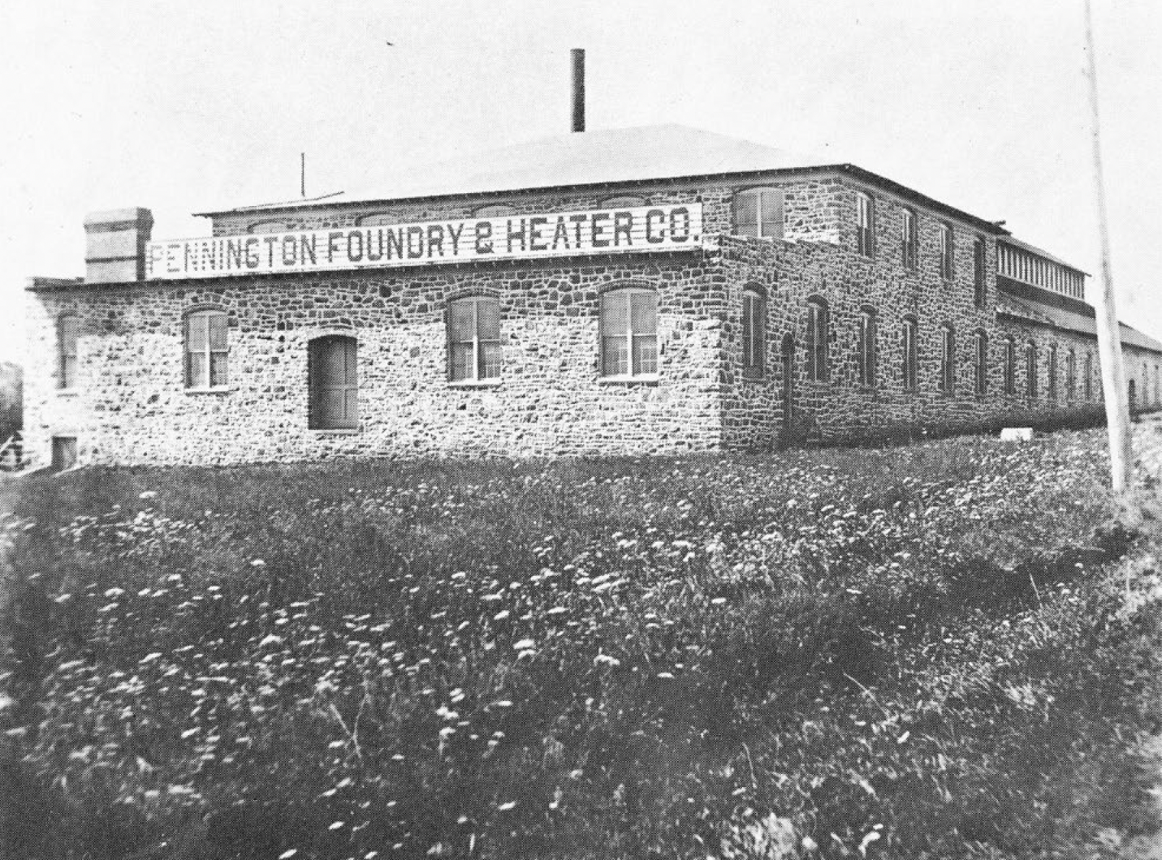
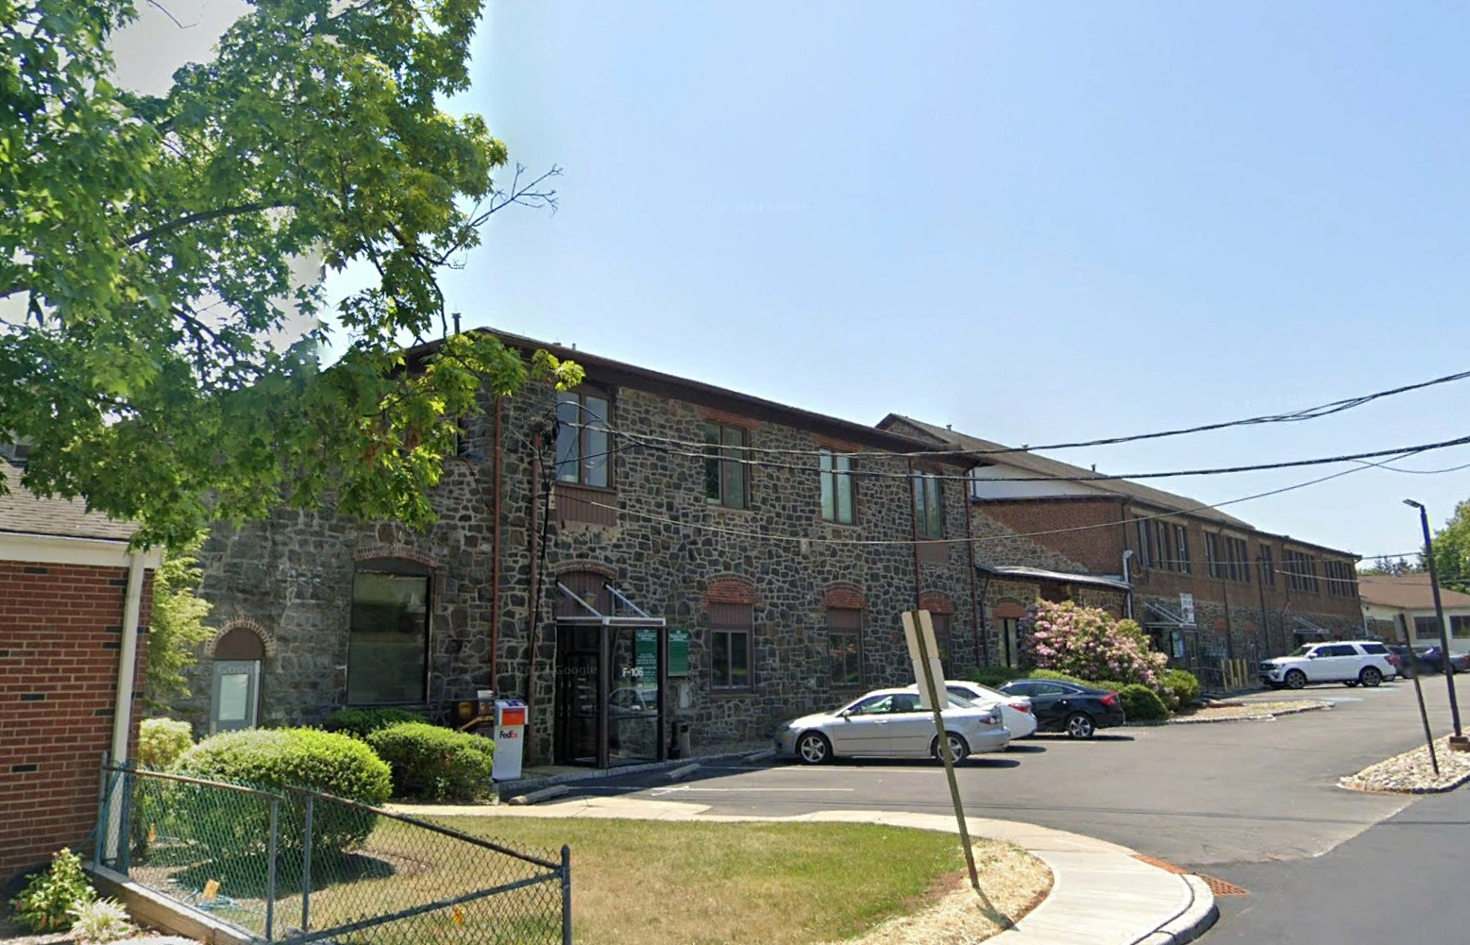
Straube Center
Then Foundry & Heater Co.
Now: Office building.
This building has had lots of uses. It was originally built for the Pennington Foundry & Heater Co. They made furnaces to heat homes. In 1914, Peerless Insulated Wire & Cable Co. took over. They made cables – wires that were coated in a fiber and then in wax to make it waterproof. In 1939, it became a candy factory called Scharf Brothers, but they were bad environmentalists and got in trouble with the neighbors for polluting a nearby stream. A good neighbor moved in after that – Mr. Cointreau, who made an orange-flavored adult beverage that he named after himself. He was very generous to the community for all the years that he had his business there, especially the library and the emergency services unit. Eventually, they went out of business and Mr. Winn Straube bought the building and turned it into an office building.

Slide 11
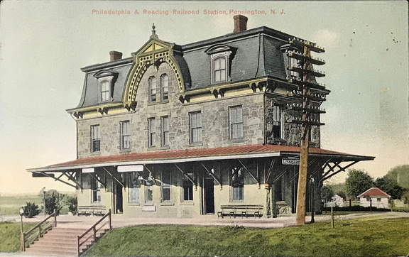
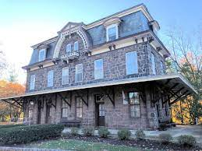
Train Station
Then- Train station
Now – Apartments
In 1876, the Delaware and Bound Brook Railroad finished its track and built a magnificent station at Pennington. The effort was strategically timed to generate ridership by providing access to the Centennial Exposition in Philadelphia. People, who up to then only had horses to transport them, could work, shop, and enjoy events away from town, then return home. Goods could be manufactured or packaged here and sent out. New products could be ordered for delivery. The train was very important then because cars wouldn’t be invented for many more years. Passenger service ended in 1967 and eventually the station was turned into apartments.

Slide 12
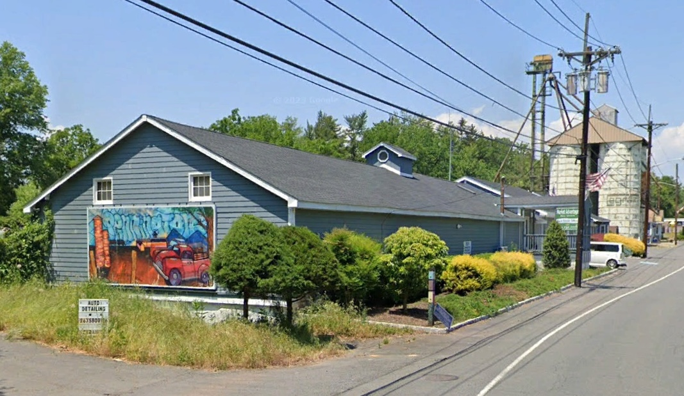
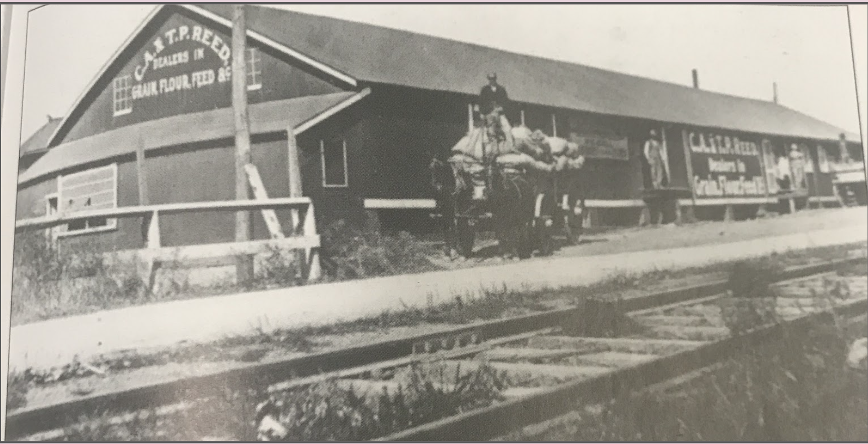
Feed Store
Then – feed store
Now – Auto detailing business
The Reed family owned a mill on the Stony Brook where they turned grain into cornmeal or flour that people bought to bake bread. The brook also was used in the winter to make ice. As the water froze over, it would be cut into blocks with a big cutter pulled by a horse. The huge pieces of ice would be picked up with tongs and put into a horse-drawn wagon for storage at an ice house. Both the grain and the ice were sold out of this store. It has been several other businesses; at the moment, it is an auto detailing shop.

